Slide 1

Building Products That Customers Want
By Gideon Karimi
Chief Solutions Officer
Product Flows
From MVP to Product Market Fit

Slide 2
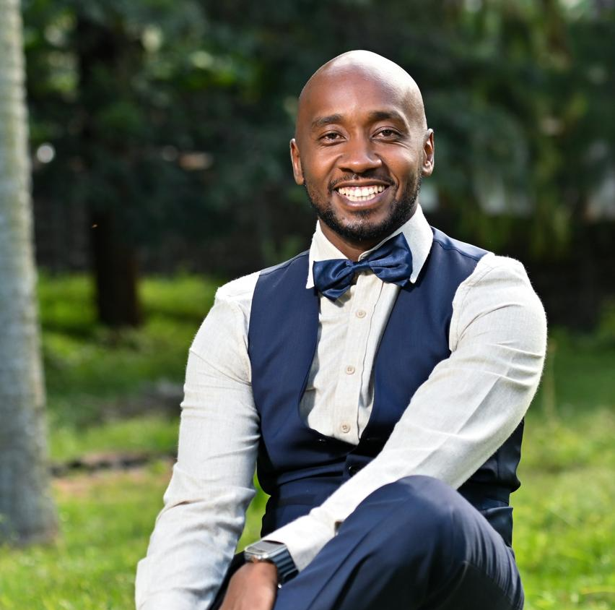
Gideon Karimi Profile
Experienced Commercial Leader with +19 Years experience building innovative customer focused solutions.
Chief Solutions Officer at Product Flows LTD
Ex Head of Products at Safaricom PLC
Drove Growth of Safaricom Mobile Internet Business through delivery of customer centric products.
https://www.linkedin.com/in/gideon-karimi/

Slide 3
To Have A Market Fit Product You Need To Be Customer Obsessed
Get Rich Customer Insight
Build The Right Product
Understand Your User Base
Experiment At Each Stages

Slide 4
Get Rich Customer Insight
Stated Feedback
Surveys, Social Media etc
Unstated Feedback
Observation, Gut feel etc
Case Study : The ”Data Dark Customer Research in collaboration with Google” that led to the birth of Lipa Mdogo Mdogo, Device Assembly, Data deals etc
“Listen Keenly to Understand Deeply”

Slide 5
Build The Right Product
Basic Expected Features
Derived from stated needs
To Drive Consideration
Delight Features
Derived from unstated need
To Drive Loyalty and Advocacy
Case Study: The “AI powered prediction models” that led to development of Make your own bundle.
“Go Beyond the Basics for unmatched differentiation”

Slide 6
Understand Your User Base
Customers
Will use you as long as the product works
Fans
Will tell everyone about your product
Case Study: The growth of Make your own bundle with only self discovery and advocacy
“The best products don’t just create users, they create evangelists”

Slide 7
Key Take Aways
Capture Customer insights to understand their needs
Uncover Hidden Needs
Have Basic Features to Meet Expectations & Have Delights to Drive Loyalty
Turn Users Into Evangelists
Experiment, Experiment, Experiment

